Slide 1
Chapter 13 Part 2

Slide 2
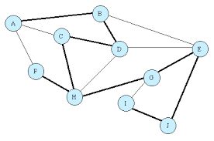
Chapter 13 Part 2: Graphs
Graph Traversals: BFS
Directed graphs

Slide 3
Breadth-First Search
L₀
A
L₁
B
C
D
L₂
E

Slide 4
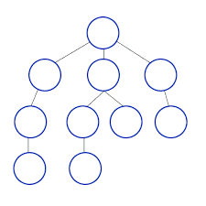
Breadth-First Search (BFS)
Breadth-first search (BFS) is a general technique for traversing a graph
A BFS traversal of a graph G
Visits all the vertices and edges of G
Determines whether G is connected
Defines a useful spanning tree
Proceeds in rounds and subdivides the vertices into levels

Slide 5
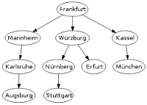
Breadth-First Search (BFS)
Breadth-first search (BFS) is a general technique for traversing a graph
A BFS traversal of a graph G
Visits all the vertices and edges of G
Determines whether G is connected
Defines a useful spanning tree
Proceeds in rounds and subdivides the vertices into levels

Slide 6

BFS Algorithm
Starts at vertex s
Level 0
Round 1
Visits and paints the vertices adjacent to s
Level 1 nodes
Round 2
Visits and paints all the vertices adjacent to the level 1 nodes
Level 2 nodes
Continue this process until all the vertices have been visited

Slide 7
Pseudo-Code for BFS(s)
initialize collection L₀ to contain vertex s
i←0
While L_{i} is not empty do
Create collection L_{i+1} to initially be empty
For all vertices v in L_{i} do
For all edges e in v.incidentEdges() do //see 13 Graphs part1.pptx
If edge is unexplored then
W←e.opposite(v) // see 13 Graphs part1.pptx
If vertex w is unexplored then
Label e as a discovery edge
Insert w in L_{i+1}
Else
Label e as a cross edge
i←i+1
L_{i} denotes level i
The collections could be queues

Slide 8
Breadth-First Search Example (1)
First visit 0, then visit all its neighbors 1, 2 ,3

Slide 9
Breadth-First Search Example (2)
Vertex 1 has three neighbors 0, 2 ,4
Since 0 and 2 have been visited, visit 4
Vertex 2 has three neighbors 0, 1, and 3 which have been visited
Vertex 4 has two neighbors 1 and 3 which have been visited
The search is complete

Slide 10
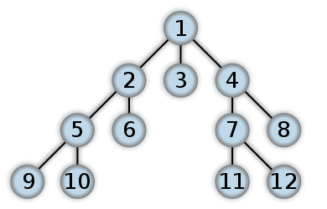
Breadth-First Order
In this example, edges on the left are visited first
BFS Order (1, 2, 3, 4, 5, 6, 7, 8, 9, 10, 11, 12)

Slide 11
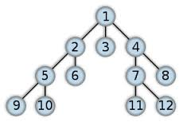
BFS Related Definitions
Discovery edges
The edges used to discover new vertices
Cross edges
The edges that lead to already discovered vertices

Slide 12
Another BFS Example - 1
L₀
unexplored vertex
A
A
A
visited vertex
L₁
B
C
D
unexplored edge
discovery edge
E
F
cross edge
L₀
L₀
A
A
L₁
L₁
B
C
D
B
C
D
E
F
E
F

Slide 13
Another BFS Example - 2
L₀
L₀
A
A
L₁
L₁
B
C
D
B
C
D
L₂
E
F
E
F
L₀
L₀
A
A
L₁
L₁
B
C
D
B
C
D
L₂
L₂
E
F
E
F

Slide 14
Another BFS Example - 3
L₀
L₀
A
A
L₁
L₁
B
C
D
B
C
D
L₂
L₂
E
F
E
F
L₀
A
L₁
B
C
D
L₂
E
F

Slide 15
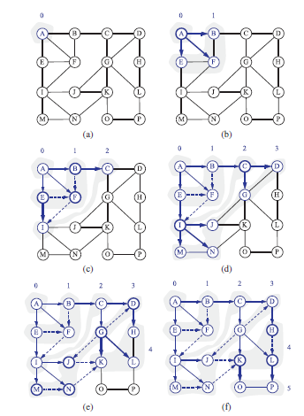
Another BFS Traversal
Figure 13.7

Slide 16
Breadth-First Search Example
BFS order
Chicago, Seattle, Denver, Kansas City, New York, Boston, San Francisco, Los Angeles, Dallas, Atlanta, Houston, Miami (choosing the west most city)

Slide 17
Breadth-First Properties
Notation
G_{s}: connected component of s
Property 1
BFS(G, s) visits all the vertices and edges of G_{s}
Property 2
The discovery edges labeled by BFS(G, s) form a spanning tree T_{s} of G_{s}
A
B
C
D
E
F
L₀
A
L₁
B
C
D
L₂
E
F

Slide 18
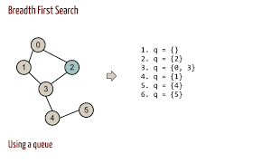
More Properties of BFS Algorithm
DFS can be further extended to solve other graph problems
Testing whether G is connected
Computing a spanning tree of G, if G is connected
Computing the connected components of G
Given a start vertex, s of G, computing for every vertex v of G, a path with the minimum number of edges between s and v, or reporting that not such path exists
Computing a cycle in G, or reporting that G has no cycles

Slide 19
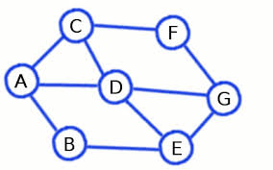
Breadth-First Analysis (1)
Setting/getting a vertex/edge label takes O(1) time
Each vertex is labeled twice
once as UNEXPLORED
once as VISITED
Each edge is labeled twice
once as UNEXPLORED
once as DISCOVERY or CROSS

Slide 20

Breadth-First Analysis (2)
Each vertex is inserted once into a sequence L_{i}
Method incidentEdges() is called once for each vertex
BFS runs in O(n + m) time provided the graph is represented by the adjacency list structure
Recall that Σ_{v} deg(v) = 2m

Slide 21
DFS vs. BFS
Applications | DFS | BFS
Spanning forest, connected components, paths, cycles | √ | √
Path with least # of edges |  | √
Biconnected components | √
A biconnected graph is a connected graph where if any vertex were to be removed, the graph will remain connected
This is especially useful in maintaining a graph with a two-fold redundancy to prevent disconnection upon the removal of a single edge (or connection)
The use of biconnected graphs is very important in the field of networking (because of this property of redundancy)
A biconnected component is the maximal biconnected subgraph

Slide 22
Directed Graphs
BOS
ORD
JFK
SFO
DFW
LAX
MIA

Slide 23
Digraphs
A digraph is a graph whose edges are all directed
Short for “directed graph”
Applications
One-way streets
Flights
Task scheduling
E
D
C
B
A

Slide 24
Digraph Application
Scheduling: edge (a,b) means task a must be completed before b can be started
ics21
ics22
ics23
ics51
ics53
ics52
ics161
ics131
ics141
ics121
ics171
The good life
(CS 1D)
ics151

Slide 25
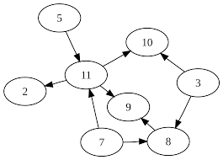
Directed Edge Methods (1)
Additional methods to the graph ADT
e.isDirected()
Tests whether edge e is directed
e.origin()
Returns the origin vertex of edge e
e.dest()
Returns the destination vertex of edge e

Slide 26
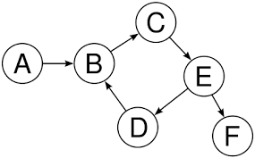
Directed Edge Methods (2)
e.insertDirectedEdge(v,w,x)
Insert and return a new directed edge with origin v and destination w and storing element x
Running time for methods
e.isDirected(), e.origin(), e.dest() is O(1)
insertDirectedEdge(v,w,x) same as for the undirected insertion

Slide 27

Reachability
Determining which vertices can be reached by a path
Vertex u reaches vertex v if G has a directed path from u to v

Slide 28
Reachability
Vertices reachable from a particular vertex via directed paths
E
D
C
E
D
A
C
F
E
D
A
B
C
F
A
B

Slide 29

Strong Connectivity
Each vertex can reach all other vertices
a
g
c
d
e
b
f

Slide 30
Strong Connectivity Algorithm
Pick a vertex v in G
Perform a DFS from v in G
If there’s a w not visited, print “no”
Let G’ be G with edges reversed
Perform a DFS from v in G’
If there’s a w not visited, print “no”
Else, print “yes”
Running time: O(n+m)
G:
a
c
g
d
e
f
b
a
G’:
c
g
d
e
f
b

Slide 31
Strongly Connected Components
Maximal sub-graphs such that each vertex can reach all other vertices in the subgraph
Can also be done in O(n+m) time using DFS
But is more complicated
a
g
{ a , c , g }
c
d
e
{ f , d , e , b }
f
b

Slide 32

Directed Cycles
Directed cycle
All the edges are traverse according to their respective cycles
Acyclic graph
Graph has no directed cycles

Slide 33
Directed Path
BOS
ORD
JFK
SFO
DFW
LAX
MIA
Direct path from BOS to LAX is shown in white

Slide 34
Directed Cycles
BOS
ORD
JFK
SFO
DFW
LAX
MIA
Directed cycle: ORD, MIA, DFW, LAX, ORD (strongly connected sub-graph) is shown in white

Slide 35
Reachability
BOS
ORD
JFK
SFO
DFW
LAX
MIA
Subgraph of vertices and edges reachable from ORD is shown in white

Slide 36
Reachability
BOS
ORD
JFK
SFO
DFW
LAX
MIA
Removing the white edges gives an acyclic digraph

Slide 37
Directed Traversals
One can specialize the traversal algorithms (DFS and BFS) to digraphs by traversing edges only along their direction

Slide 38

Types of Edges (1)
In the directed DFS algorithm, there are four types of edges
Discovery or tree edges
A DFS on a digraph partitions the edges of a graph G reachable from the starting vertex into discovery or tree edges (leads to discovery of new vertices)
Back edges
Connects a vertex to an ancestor in the DFS tree

Slide 39
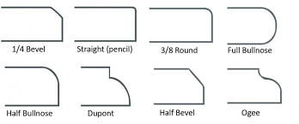
Types of Edges (2)
Forward edges
Connects a vertex to a descendant in the DFS tree
Cross edges
Connects a vertex to a vertex that is neither an ancestor or descendant

Slide 40
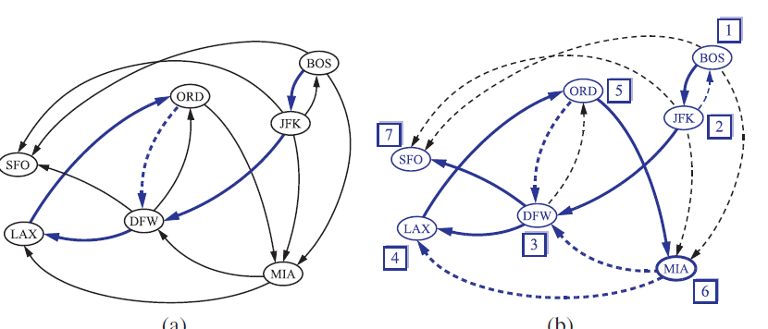
Digraph DFS Example
The order in which the vertices are visited is indicated by a label next to each vertex
See Figure 13.9 (page 628) – DFS starting at BOS
Discovery edges – solid lines, Back edges – dashed blue lines
Forward and Cross edges – dashed black lines

Slide 41
Another Digraph DFS Example
A directed DFS starting a vertex v determines the vertices reachable from v
E
D
Starting at vertex
A
C
Discovery edge
B
Forward edge
Back edge
Cross edge
A

Slide 42
Digraph BFS Example
A
B
C
D
Discovery edges
E
F
G
H
Cross edges
I
J
K
L
Back edges
M
N
O
P
There are no forward edges in BFS Digraphs

Slide 43
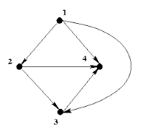
Proposition 13.16
Let G be a digraph
A depth first search on G starting a vertex s visits all the vertices of G that are reachable from s
The DFS tree contains directed paths from s to every vertex reachable from s

Slide 44
Transitive Closure
Given a digraph G, the transitive closure of G is the digraph G* such that
G* has the same vertices as G
if G has a directed path from u to v (u ≠ v), G* has a directed edge from u to v
The transitive closure provides reachability information about a digraph
D
E
B
G
C
A
D
E
B
C
A
G*

Slide 45
Computing the Transitive Closure
Perform DFS starting at each vertex
Performance: O(n(n+m))
If there's a way to get from A to B and from B to C, then there's a way to get from A to C
Use the Floyd-Warshall Algorithm

Slide 46
Floyd-Warshall Transitive Closure Overview
Number the vertices 1, 2, …, n
Consider paths that use only vertices numbered 1, 2, …, k as intermediate vertices
Uses only vertices numbered 1,…, k
(add this edge if it’s not already in)
i
j
Uses only vertices
numbered 1,…, k-1
k
Uses only vertices
numbered 1,…, k-1

Slide 47
Floyd-Warshall’s Algorithm
Number vertices v₁ , …, v_{n}
Compute digraphs G₀, …, G_{n}
G₀=G
G_{k} has directed edge (v_{i} , v_{j}) if G has a directed path from v_{i} to v_{j} with intermediate vertices in {v₁ , …, v_{k}}
We have that G_{n} = G*
In phase k, digraph G_{k} is computed from G_{k − 1}

Slide 48
Floyd-Warshall’s Algorithm
Algorithm FloydWarshall(G)
Input digraph G
Output transitive closure G* of G
let v₁ , …, v_{k} be an arbitrary numbering of the vertices of G
G₀ ← G
for k← 1 to n do
G_{k} ← G_{k-1}
for all i, j in {1,…n} with i!=j and j !=k do
if both edges {v_{1,} v_{k}} and {v_{k,} v_{j}} are in G_{k-1} then
add edge {v_{1,} v_{j}} to G_{k} (if it is not already present)
return G_{k}

Slide 49
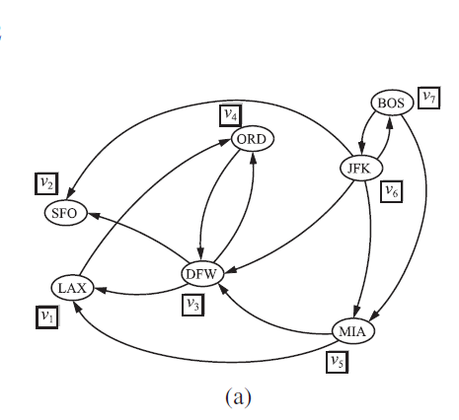
Floyd-Warshall Example
Figure 13.10
Page 632
(a)
initial digraph G = G₀ and numbering of the vertices

Slide 50
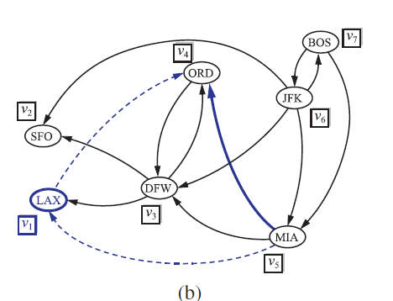
Floyd-Warshall Example
New paths:
MIA-ORD
Intermediate vertex
New edge
(b) digraph G₁

Slide 51
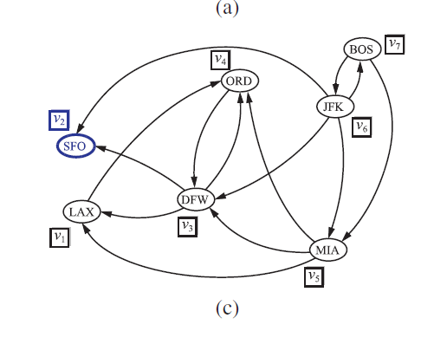
Floyd-Warshall Example
New paths:
MIA-ORD
(c) digraph G2

Slide 52
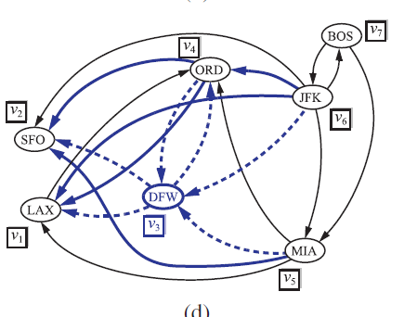
Floyd-Warshall Example
New paths:
MIA-ORD
MIA-SFO
ORD-SFO
ORD-LAX
JFK-ORD
JFK-LAX
(d) digraph G3

Slide 53
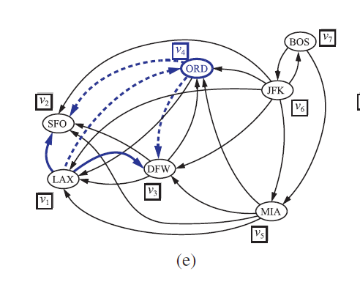
Floyd-Warshall Example
New paths:
MIA-ORD
MIA-SFO
ORD-SFO
ORD-LAX
JFK-ORD
JFK-LAX
LAX-DFW
LAX-SFO
(e) digraph G4

Slide 54
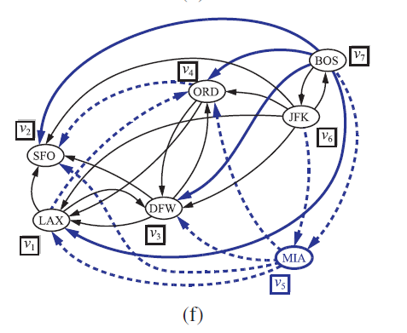
Floyd-Warshall Example
New paths:
MIA-ORD
MIA-SFO
ORD-SFO
ORD-LAX
JFK-ORD
JFK-LAX
LAX-DFW
LAX-SFO
BOS-DFW
BOS-ORD
BOS-LAX
BOS-SFO
(f) digraph G5= G6= G7

Slide 55
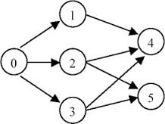
Directed Acyclic Graphs (DAG)
Digraphs without directed cycles
Applications
Inheritance between C++ classes
Prerequisites between courses for a degree program
Scheduling constraints between tasks on a project

Slide 56
Topological Ordering
An ordering v₁, …, v_{n} of the vertices of a graph such that for every edge (v_{i,} v_{j}), i < j
Any directed path traverses vertices in an increasing order
A graph has an topological ordering if and only if it is acyclic

Slide 57
Topological Ordering Example
Number vertices, so that (u,v) in the digraph implies u < v
A typical student day
wake up
1
2
3
eat
study computer science
4
5
nap
more C.S.
Not unique
7
play
8
write C.S. program
6
9
work out
make cookies for professor
10
sleep
11
dream about graphs
Nothing is particularly hard if you divide it into small jobs…. Henry Ford

Slide 58
Algorithm for Topological Sorting
Topological sorting is used to compute a topological ordering
Method TopologicalSort(G)
H ← G // Temporary copy of G
n ← G.numVertices()
while H is not empty do
Let v be a vertex with no outgoing edges
Label v ← n
n ← n - 1
Remove v from H
Note: This algorithm is different than the one in the Goodrich-Tamassia text

Slide 59
Topological Sorting Example
In this example, when there are multiple choices, the node to the left is chosen

Slide 60
Topological Sorting Example
9

Slide 61
Topological Sorting Example
8
9

Slide 62
Topological Sorting Example
7
8
9

Slide 63
Topological Sorting Example
6
7
8
9

Slide 64
Topological Sorting Example
6
5
7
8
9

Slide 65
Topological Sorting Example
4
6
5
7
8
9

Slide 66
Topological Sorting Example
3
4
6
5
7
8
9

Slide 67
Topological Sorting Example
2
3
4
6
5
7
8
9

Slide 68
Topological Sorting Example
2
1
3
4
6
5
7
8
9

